Slide 1
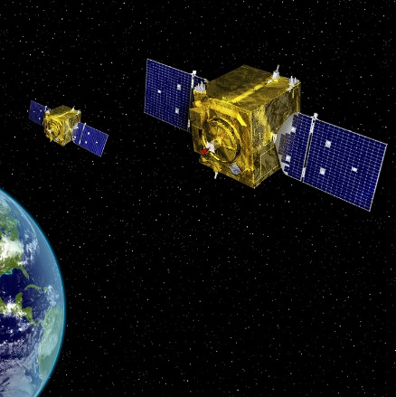
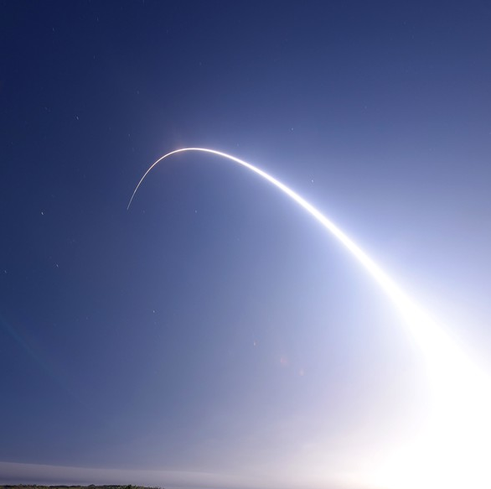
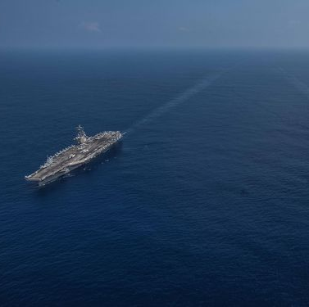

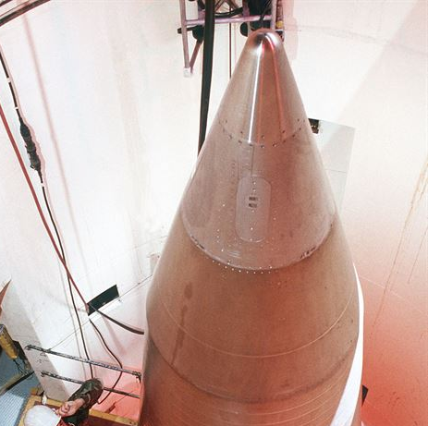

Schools of Operational Thought on Space
Space Control First
Enable Global Missile War
Keep the Plumbing Running
Frictionless Intelligence
Nukes Matter Most
Galactic Battle Fleet
Differing assumptions about the future of war and how to respond
Approved for public release. OTR 2019-00865.
Notes:
SCF: Artist Rendering, VIRIN: 150415-F-AS483-001.JPG https://www.afspc.af.mil/News/Photos/igphoto/2001040892/
EGMR: Photo by: Adam Hartman | VIRIN: 160225-F-DD985-005.JPG https://dod.defense.gov/Photos/Photo-Gallery/igphoto/2001809039/
KPR: Photo Source: U.S. Navy photo by Mass Communication Specialist 2nd Class Kaila V. Peters), 181009-N-PJ626-0001, https://navylive.dodlive.mil/2018/10/10/your-navy-operating-forward-iceland-england-singapore/181009-n-pj626-0001/
FI: Photo source: https://de.wikipedia.org/wiki/Datei:All_seeing_eye.jpg
NMM: A maintainer looks over a Minuteman III in a silo about 60 miles from Grand Forks AFB, N.D., in 1989. (U.S. Air Force photo https://www.nationalmuseum.af.mil/Visit/Museum-Exhibits/Fact-Sheets/Display/Article/196676/boeing-lgm-30g-minuteman-iii/
GBF: ESA (European Space Agency)/Hubble & NASA https://www.nasa.gov/image-feature/goddard/2018/hubble-captures-cluster-of-aging-stars

