Slide 1
Do-It-Yourself Satellites
Applications for Citizen Space
Jake Singh
Software Systems Assurance
The Aerospace Corporation
September 17, 2019
Approved for public release. OTR 2019-01123.

Slide 2
Citizen Space
Background and Market Drivers
Citizen Space Participants
  “Citizen space participants are not motivated by profit nor are they members of government agencies; rather, they seek to leverage the assets of commercial space (affordable launch, small satellites) for scientific purposes typically associated with civil space agencies like NASA or NOAA”
  Participants need low financial and technical barriers to entry
Drivers of Citizen Science
  Creative Disruption
    Unconventional players bring unconventional ideas
  Lower Cost Threshold
    CubeSats, drones, open-source software, smartphones, etc.
  Independent Validation
    Quartz piezoelectric resonator first validated by amateur radio community
  Crowd-sourced Wisdom
    Citizen scientists have discovered distant exoplanets, new auroras

Slide 3
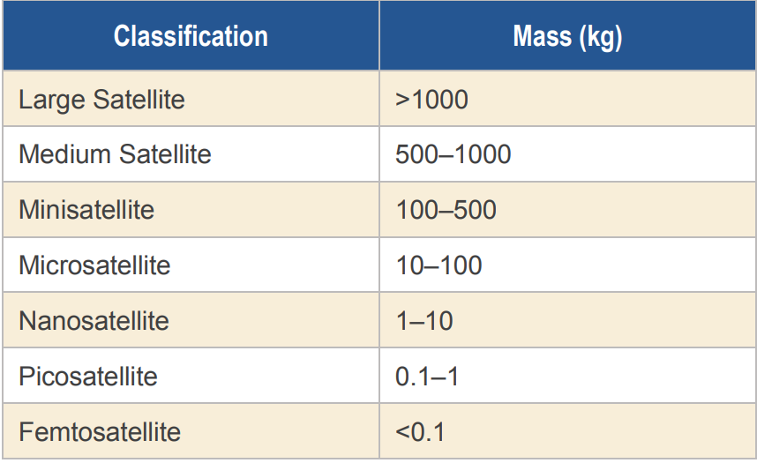
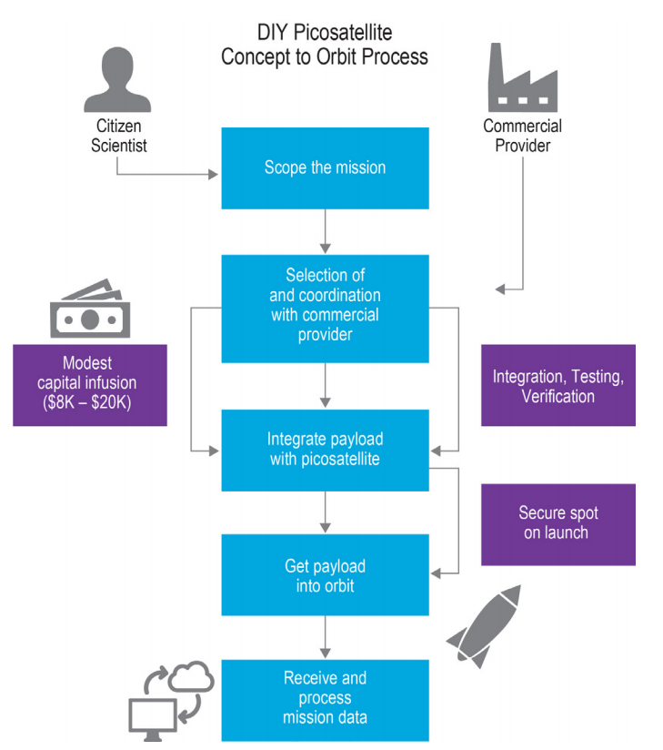
DIY Picosatellites
New Asset for Citizen Space
Key Enabling Elements
Path to Hosted Payloads
Low Orbital Altitude and Lifespan
Compact and Flexible Configurations
Internet-based Telemetry Streaming
Plug-and-Play Avionics
Customer Interface
Open-source Software

Slide 4
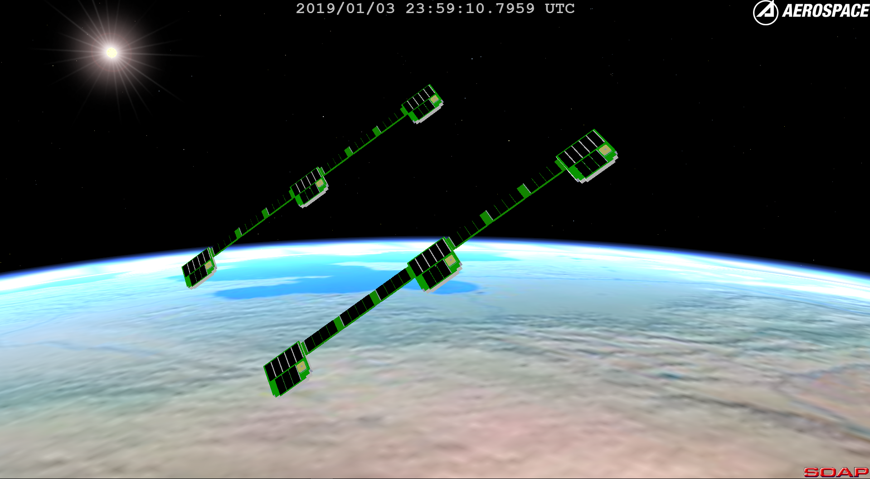
Examples
ThinSat
  “Slice of bread” shape
  3-Phase STEM education program
  Successful 1st launch on April 17, 2019. 400+ students represented
  Developed by Virginia Space and Twiggs Space Labs
ThumbSat
  Streamlined concept-to-orbit process
  Technical guidance for experiment design
  $20,000 reported total mission cost
  Regulatory challenges
    Denied FCC license over trajectory uncertainty, command and communication abilities
TubeSat
  Small satellite kit developed by Interorbital Systems
  Successful launch in 2016 for middle school students in Brazil
  $8000 reported cost for academic use

Slide 5
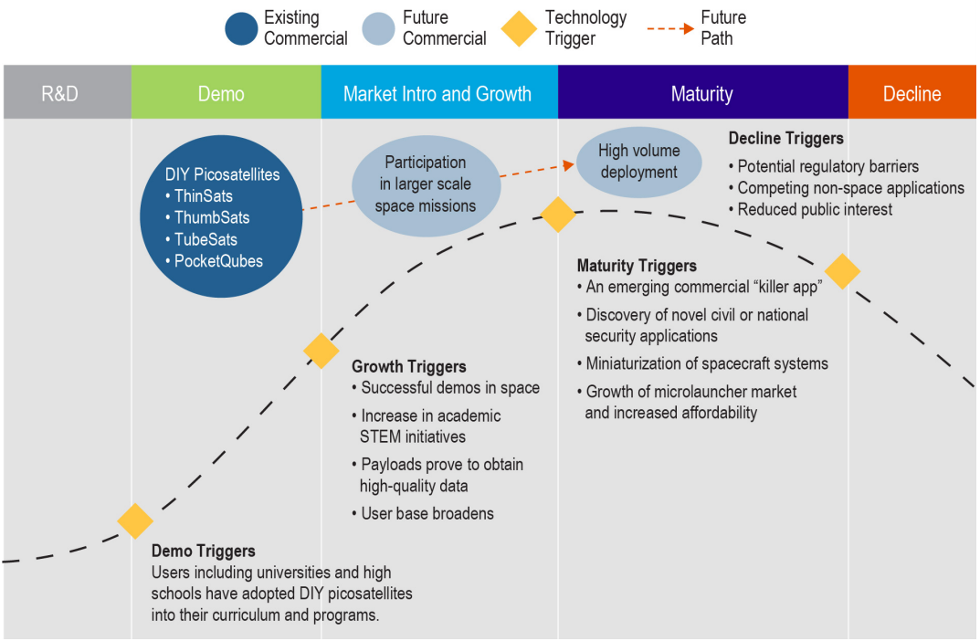
Game Changer Lifecycle
Anticipated Maturity Curve

Slide 6
Implications of Increased Demand
Users, Technology, Regulation
Picosatellite Users
  Space democratization
  STEM programs inspire future space leaders
Space Technology
  Advancement of novel space technologies
  Novel applications of picosatellites
Regulatory Concerns
  Debris mitigation
  Tracking

Slide 7
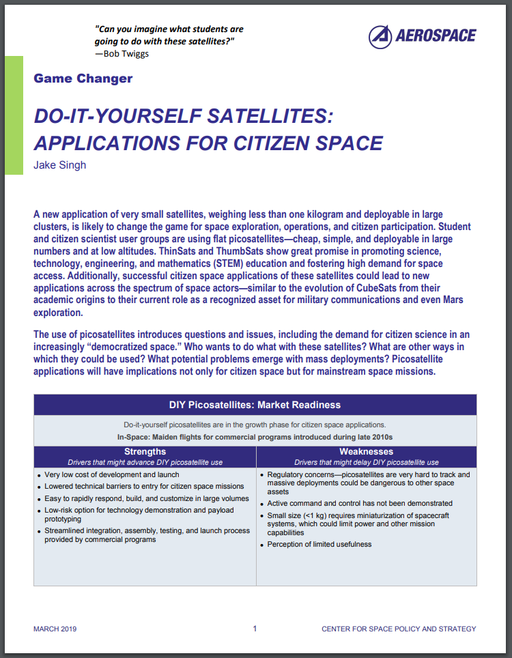
Conclusion
Read More!
DIY picosatellites are in the demo/growth phase
Maiden flights for commercial programs introduced over the past few years
High potential to increase citizen space participation
Potential for technology advancement and innovative applications
Regulatory concerns may accompany a rise in popularity
Link to paper:
https://aerospace.org/paper/game-changer-diy-sats-citizen-space

